Slide 1
CLOUD NETWORKING PROJECT
Azure Function App
with VNet Integration
& Private Database Access
A secure serverless connectivity workflow using Azure Functions,
Virtual Network integration and an Azure SQL backend.
AZURE FUNCTIONS
VNET
PRIVATE ACCESS
Project Presentation
2026

Slide 2
01 | CONTEXT
02
Why this architecture?
A serverless function still needs secure, reliable access to backend data.
Public exposure risk
Private connectivity
Operational simplicity
Database endpoints should not be treated as the default path for application traffic. Network controls reduce the attack surface.
VNet integration gives the Function App a path into the virtual network for backend communication.
Azure Functions handles the application runtime while Azure networking and SQL provide the infrastructure layer.
Core idea
Function App → VNet → Database
AZURE FUNCTION APP • VNET INTEGRATION • PRIVATE ACCESS

Slide 3
02 | OBJECTIVES
03
What we implemented
01
Create the Azure resource foundation
02
Configure virtual networking
Resource group, Function App and database resources.
VNet with a dedicated integration subnet.
03
Connect the function to the database
04
Validate the deployment
Python function uses database connectivity through application configuration.
Run the HTTP function and inspect execution logs.
AZURE FUNCTION APP • VNET INTEGRATION • PRIVATE ACCESS

Slide 4
03 | ARCHITECTURE
04
End-to-end connectivity
→
→
VNet
subnet-integration
→
Client / HTTP Request
Azure Function App
Azure SQL / DB
Application path
Network path
Data path
HTTP trigger starts the function.
VNet integration provides the backend network route.
Function connects to the configured database endpoint.
AZURE FUNCTION APP • VNET INTEGRATION • PRIVATE ACCESS

Slide 5
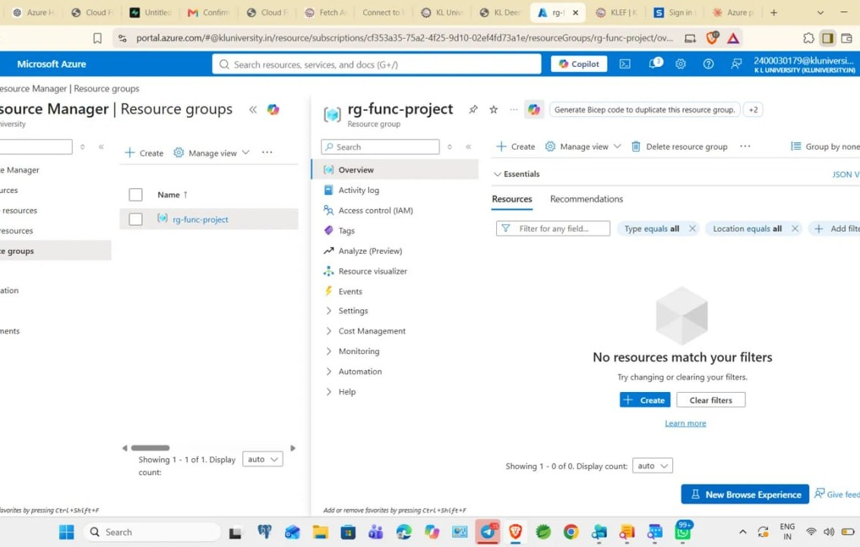
04 | AZURE SETUP
05
Resource foundation
Function App
Serverless execution layer for the HTTP-triggered Python function.
Database service
Azure SQL / database backend configured for application connectivity.
Networking
Resource group
Virtual Network and integration subnet form the private connectivity layer.
The Azure portal shows the project resource group used as the deployment container.
AZURE FUNCTION APP • VNET INTEGRATION • PRIVATE ACCESS

Slide 6
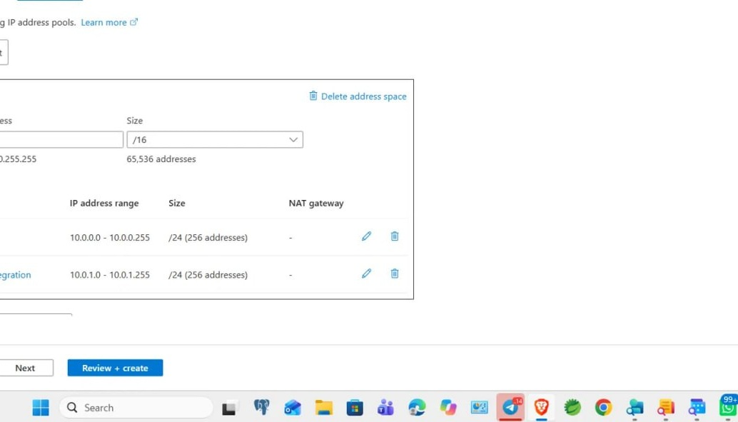
05 | NETWORKING
06
VNet integration subnet
Observed network layout
• Address space: 10.0.0.0/16
• default subnet: 10.0.0.0/24
• subnet-integration: 10.0.1.0/24
• Dedicated subnet used for Function App integration
Key point
Separate integration subnet keeps the network design explicit.
AZURE FUNCTION APP • VNET INTEGRATION • PRIVATE ACCESS

Slide 7
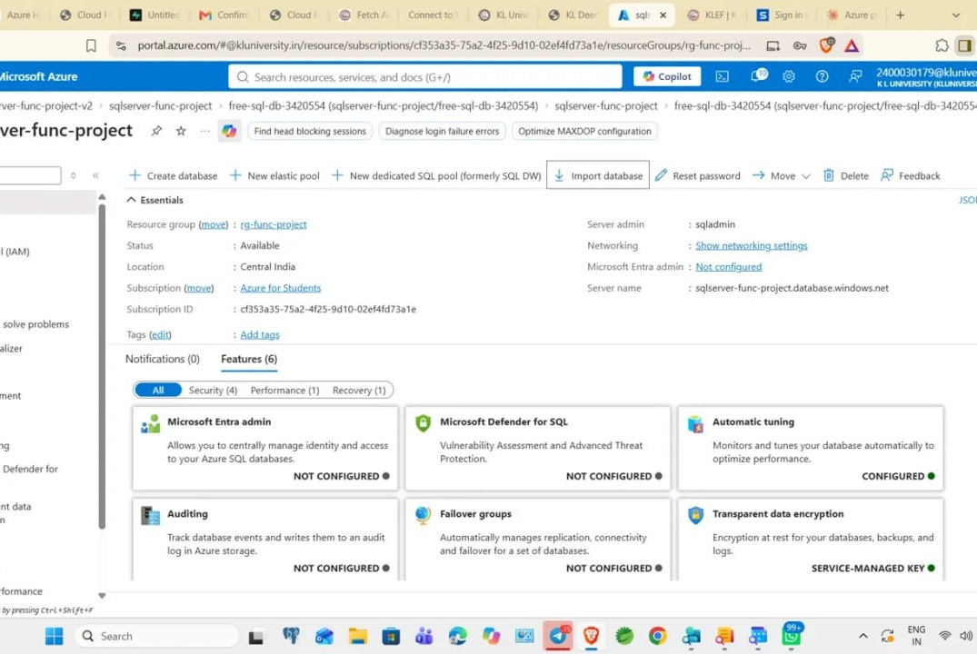
06 | BACKEND
07
Database configuration
Azure SQL server overview
• Server status shown as Available
• Central India region is visible in the portal
• SQL server is associated with the project resource group
• Networking settings are exposed from the server overview
DATABASE BACKEND
AVAILABLE
AZURE FUNCTION APP • VNET INTEGRATION • PRIVATE ACCESS

Slide 8
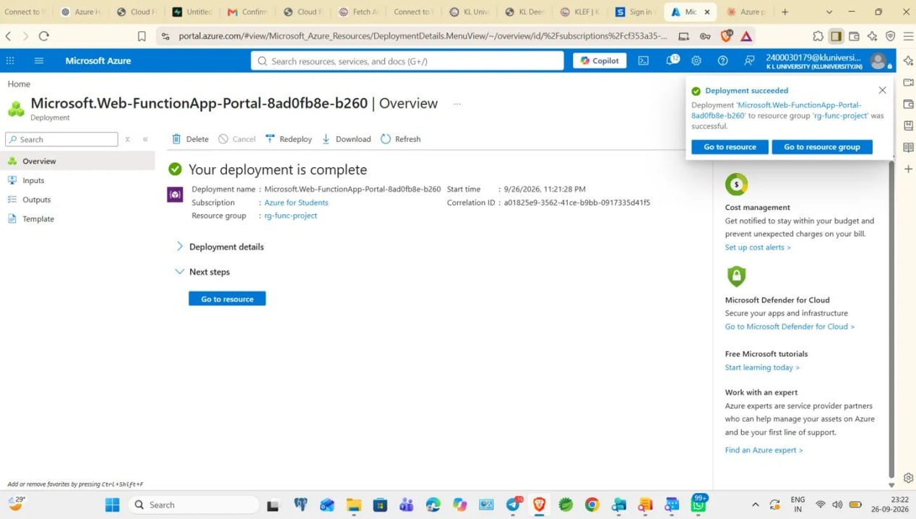
07 | DEPLOYMENT
08
Function App deployment
Deployment checkpoint
The Azure deployment page reports:
Deployment is complete
• Deployment resource group: rg-func-project
• Portal provides a direct “Go to resource” path
• This confirms the Function App resource deployment step
DEPLOYMENT SUCCEEDED
AZURE FUNCTION APP • VNET INTEGRATION • PRIVATE ACCESS

Slide 9
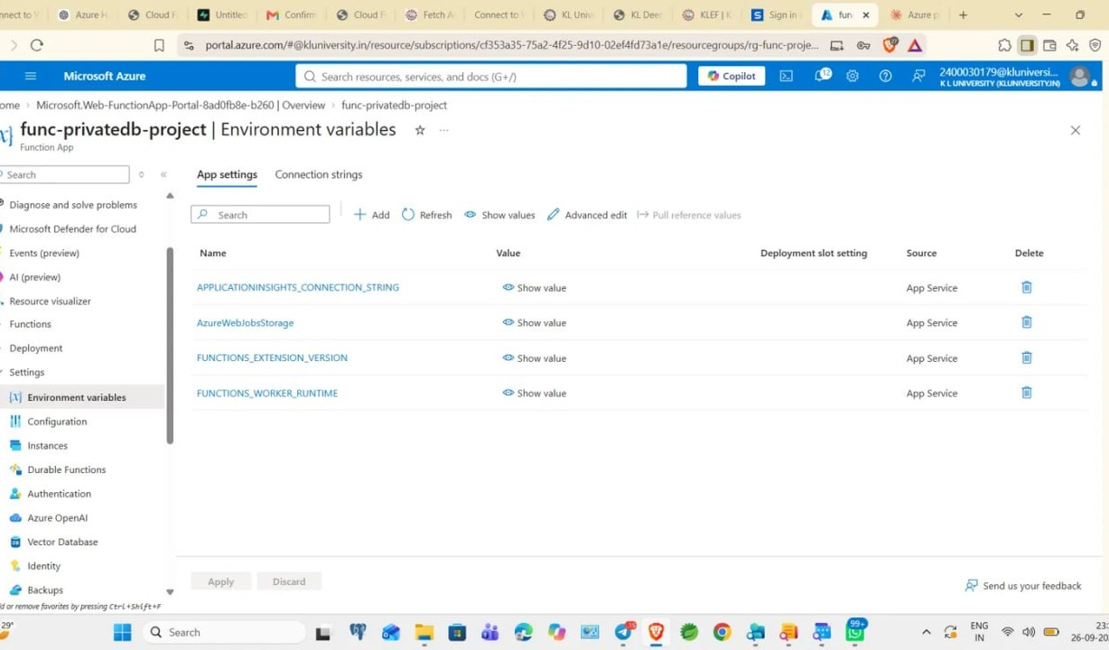
08 | CONFIGURATION
09
Application settings
Environment variables
• AzureWebJobsStorage
• FUNCTIONS_EXTENSION_VERSION
• FUNCTIONS_WORKER_RUNTIME
• Application Insights connection string
Security practice
Keep database credentials and connection strings in configuration—not hard-coded in source.
AZURE FUNCTION APP • VNET INTEGRATION • PRIVATE ACCESS

Slide 10
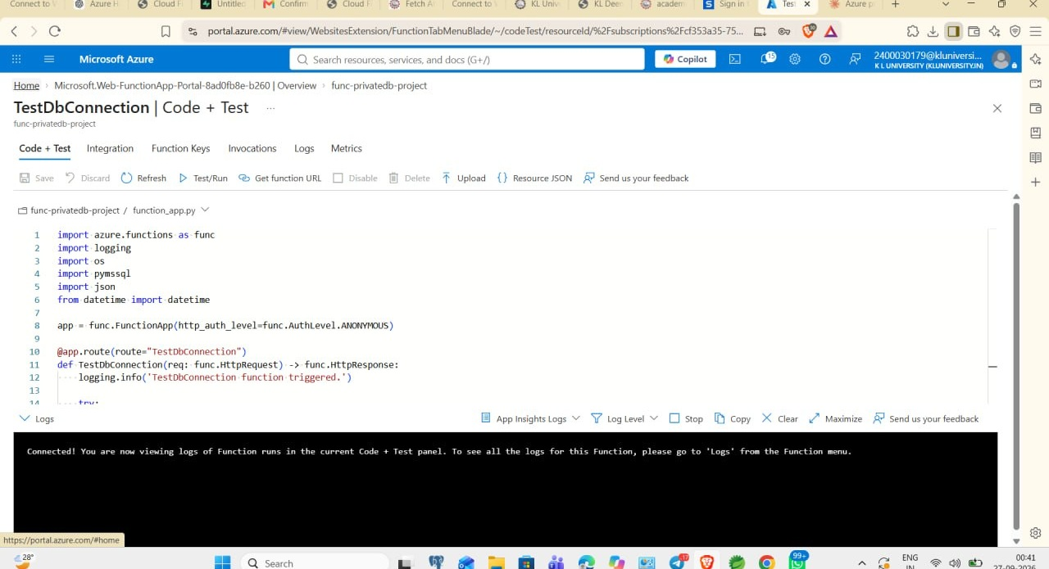
09 | VALIDATION
10
Expected output & test evidence
TEST / RUN
HTTP trigger executes
successfully
• Function route: TestDbConnection
• Execution log shows the function was triggered
• Use the log output to verify database connection behavior
• Expected final state: request reaches Function App and the backend connection is tested
EXPECTED OUTPUT
AZURE FUNCTION APP • VNET INTEGRATION • PRIVATE ACCESS

Slide 11
10 | RESULTS
11
What the implementation demonstrates
SERVERLESS
Azure Function App provides the execution layer.
NETWORKED
VNet contains a dedicated integration subnet.
BACKEND
Azure SQL/database resource is available to the application path.
VALIDATED
Portal deployment and function execution logs provide test evidence.
Overall flow
HTTP Request → Function App → VNet Integration → Database
AZURE FUNCTION APP • VNET INTEGRATION • PRIVATE ACCESS

Slide 12
11 | CONCLUSION
12
Key takeaways
The project connects a serverless workload to a backend through a controlled Azure network design.
• Azure Function App was deployed successfully.
• A VNet and dedicated subnet-integration were configured.
• Azure SQL/database resources were provisioned and available.
• Application settings provide the runtime configuration layer.
• The TestDbConnection HTTP function supplies an execution checkpoint through Azure logs.
Final architecture: Serverless + Network Integration + Controlled Backend Connectivity
Final architecture: Serverless + Network Integration + Controlled Backend Connectivity
AZURE FUNCTION APP • VNET INTEGRATION • PRIVATE ACCESS

Slide 13
THANK YOU
Azure Function App with VNet Integration
& Private Database Access
Questions & Discussion
FUNCTION
→
VNET
→
DATABASE
Project presentation • 2026

Slide 14
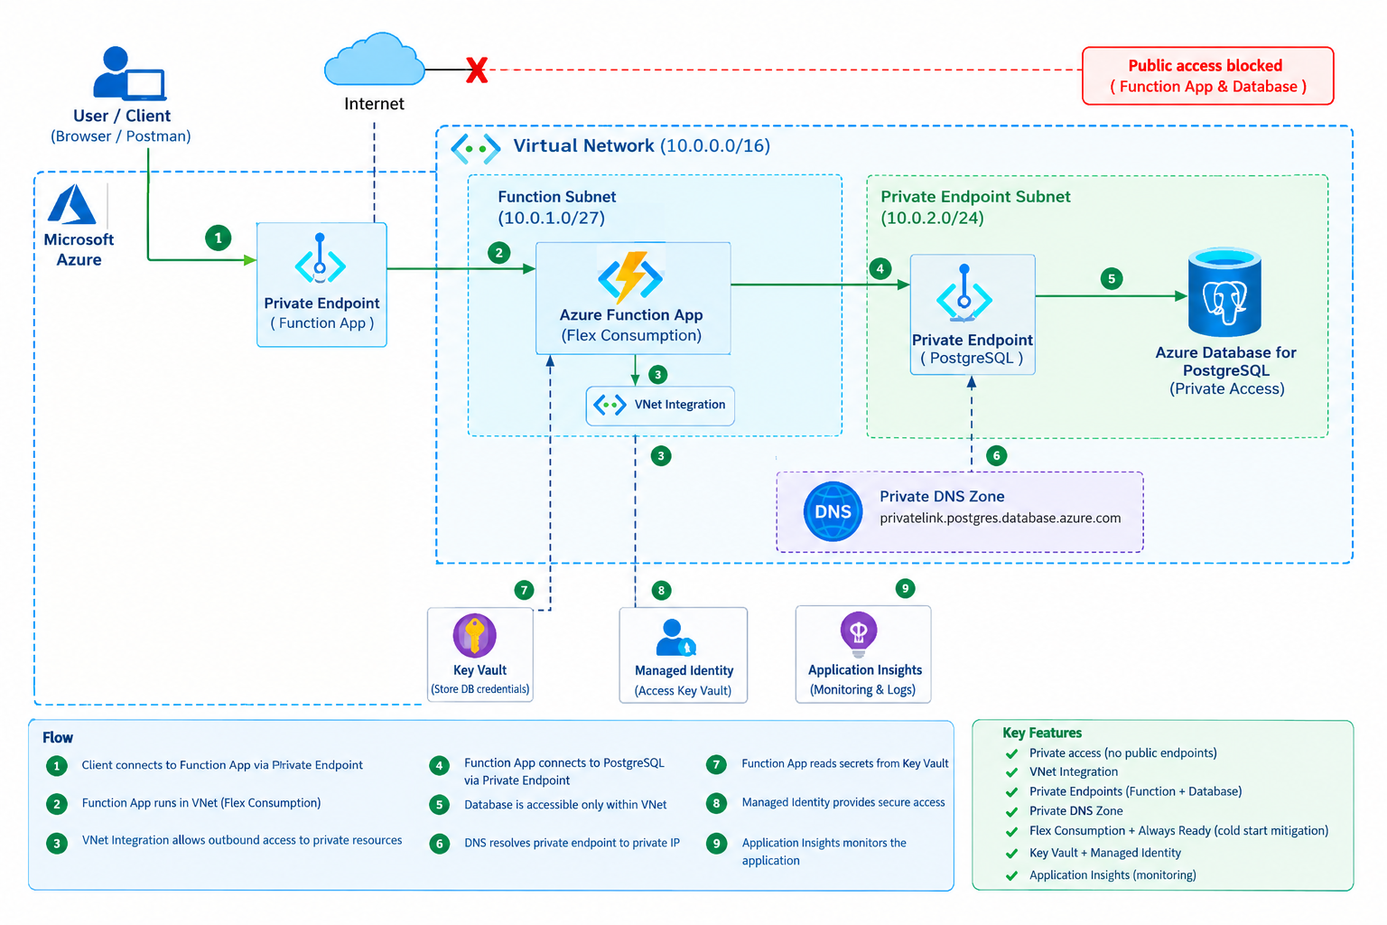
WORKING PROTOTYPE — SECURE AZURE ARCHITECTURE
Working prototype • Private Function App • VNet Integration • Private PostgreSQL Endpoint • Private DNS • Key Vault • Managed Identity • Application Insights

